Slide 1
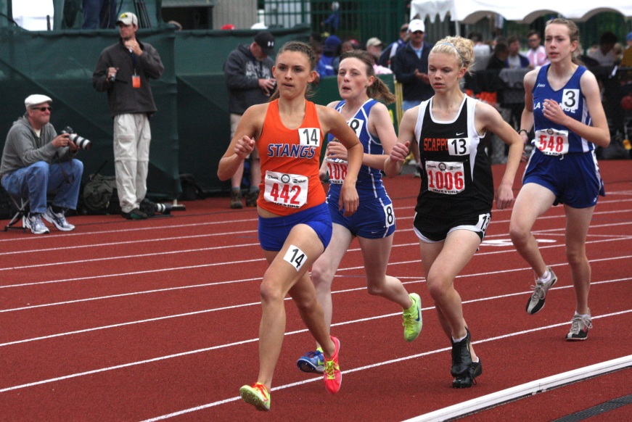

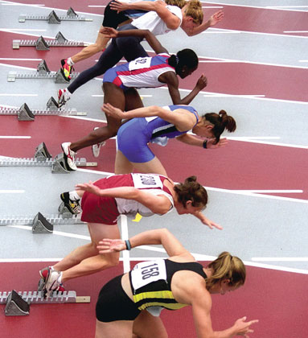
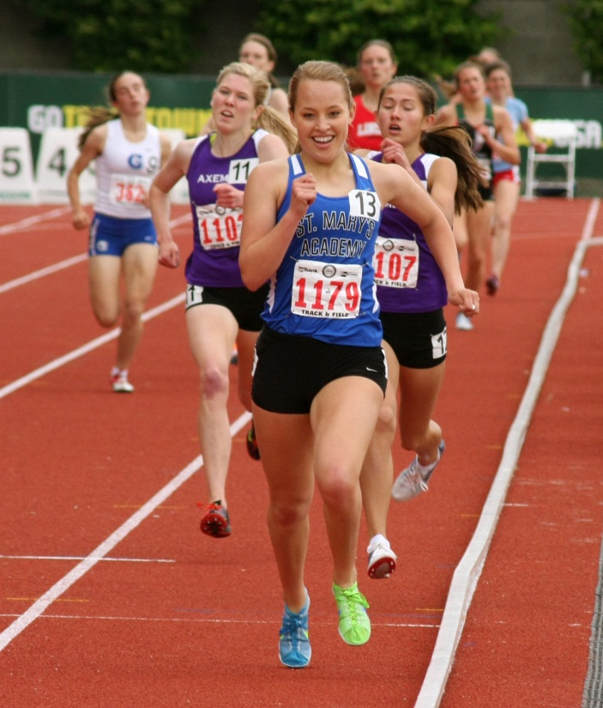
Welcome to HPMS Girls Track&Field!

Slide 2
HPMS Girl’s Track and Field 2015
7th Grade Coaches:
- Ben Fuqua (Mid/Long Distance) : fuquab@hpisd.org
- Colleen Johnson ( Sprints ) : johnsoc@hpisd.org
- Korrey Hansen ( Field Events) : hansenk@hpisd.org
- Bridget Beatty (Field Events) : beattyb@hpisd.org
8th Grade Coaches:
- Ben Fuqua (Mid/Long Distance) : fuquab@hpisd.org
- Julianne Harper ( Sprints ) : harperj@hpisd.org
- Colleen Johnson(Field Events) : johnsoc@hpisd.org
- Bridget Beatty (Field Events) : beattyb@hpisd.org

Slide 3
Girl’s Field Event Coaches
Shot = Chase Davis (boys/girls event coach)
Discus = Korrey Hansen
Long Jump = Ben Fuqua/Colleen Johnson
Triple Jump = Colleen Johnson/Ben Fuqua
High Jump = Bridget Beatty
Pole Vault = Chris Miller (boys/girls event coach)
Hurdles = Julianne Harper
**Relays** = Julianne Harper, Colleen Johnson

Slide 4
Field Event Practice Times
7th Grade = 7:30 – 8:30am
- Be to school by 7:15am. Girls will be stretched and warmed up ready to start running at 7:30am.
8th Grade = 2:30 – 4:30pm (exact practice end time is determined by the event coach but can go until 4:30pm)
_______________________________________________________________
Running Event practice is during the period, and for a short time AFTER school for 8th graders.
Field Event athletes do strength/conditioning work during the period.
*** Some 7th Grade field event practices MAY occur after running workouts in the morning. When this happens those athletes do no need to attend field event practice AFTER school unless told too by their event coach. ***

Slide 5
Field Event Practice Days
Shot = Tues/Thurs
Discus = Mon/Wed
Long J. = Tues/Thurs
Triple J. = Tues/Thurs
Pole Vault = Mon-Thurs
Hurdles = Tues/Thurs
High Jump = Mon, Wed, Thurs
Relay Handoffs = TBD

Slide 6
Events for Athletes
Each athlete will get to try out for each track meet.
We take 3 girls and an occasional 4th alternate to each meet in each event. Some meets allow 4 athletes per event.
Each athlete can be entered into a TOTAL of 5 events. (3run/2field OR 3field/2run)
Running events take precedence over field events. If conflicting running and field events happen during a meet, the athlete will do the running event.

Slide 7
2015 Track Meets
2/24 – Parent Meeting 5:00pm (7/8 assembly room)
3/19 – Tri-City Meet hosted by HP. @ McKinney North HS. (THUR)
3/26 –Princeton Meet 4pm. (THUR) @ Clark Junior High, Princeton TX.
4/4 – OPEN (no meet at this time but might be scheduled later)
4/10 – District Meet 4pm. @ Ron Poe Stadium, McKinney. (FRIDAY)

Slide 8
Day of Track Meet Schedule
Athletes who made the roster for the event will be dismissed around 2pm to the locker rooms.
Athletes dress in uniform and sweats, then board the buses.
We provide transportation for student to and from the meets.
AFTER their events, athletes can leave with ONLY their own parent, but MUST give coaches a signed transportation slip before the start of the meet and sign out on the sign out sheet to leave.
Athletes should bring their own snacks and fluids.
Concessions are usually available.
We expect to return to HPMS from track meets on the buses around 10pm

Slide 9
Track Meet Order
Field Events – start at 4pm.
Long Jump
Triple Jump
High Jump
Pole Vault
Discus
Shot Put
Track Events – in order…
2400m
4x100m relay
800m
100m hurdles
100m
4x200m relay
400m
300m hurdles
200m
1600m
4x400m relay

Slide 10
Expectations of the Athlete
Maintain good academic standing
Positive example to team, family, community
Attend and participate in ALL practices and meets.
Take care of all checked out equipment. Damaged equipment must be paid for at end of season.
Report ALL injuries to coaches for referral to the High School trainers.
All doctor’s/dentist/orthodontist appointments should be scheduled away from practice and competition times.
Coaches must be informed if practice is missed due to tutorials. Athletes should do their best to attend tutorials as needed during times that DO NOT conflict with track.
If there is a conflict with an outside school activities, vacation, or any club sport or private coaching…..HPMS track and field WILL take priority. No exceptions. If an athlete is involved with club running/track or private running/track coaching they may NOT participate in these from 2/16 – 4/10 if they are a part of the HPMS Track & Field team(HP District Policy)
*** Failure to meet or comply with team expectations may result in disciplinary action including parent conferences, suspension from meets, and/or removal from the team. ***

Slide 11
Team Discipline
If there are discipline issues at school with an HPMS Track and Field athlete the athlete will be suspended for the next Track Meet.
Common discipline issues include “lunch duty”, ISS, Lunch ISS, School Suspension, detention, and Teacher Write-Ups.
This discipline policy is approved by the District Athletic Administration and applies to Middle School and High School girls Track&Field athletes.

Slide 12
HPMS Girl’s Track and Field Records
Shot put : Laura Edwards – 35’8” (2010)
Discus : Megan Gallagher – 102’4” (1999)
Long Jump : Maddie Hammer – 17’2” (2011)
Triple Jump : Falyn Reaugh – 36’2” (2013)
High Jump : Falyn Reaugh – 5’8” (2013)
Pole Vault : Maggie Dooley – 9’0” (2009)
100m Hurdles : Kendall McCulloch – 15.94 (1993)
300m Hurdles : Gabby Crank – 47.28 (2011)
100m : Kendall Jordan – 12.3 (1982)
200m : Leah McLeod – 25.3 (2000)
400m : Maddy Stephens – 61.41 (2015)
800m : Sara Sutherland – 2:20 (2006)
1600m : Natalie Rathjen – 5:11.00 (2010)
2400m : Natalie Rathjen – 7:57.00 (2010)
3200m : Caroline Pollock – 12:21.54
4x100m Relay : Ashley Young, Beccah Sullivan, Becca Ellis, Avery Young –
50.93 (1998)
4x200m Relay : Lauren Murray, Kendrick Carlin, Cari Owens, Brooke Blessing –
1:48.03 (1992)
4x400 Relay :
Julie Lowe, Carolyn Hutcheson, Alice Burch, Kathy Bass
4:18.00 (1984)
Margaret Gottsacker, Claire Paschal, Caroline Cartwright, Sara Sutherland
4:18.00 (2006)

Slide 13
2014 7th graders (current 8th grade)
2014 Prosper Track Meet =
HP – 339.5 *won 15 of 17 events*
Prosper - 193
Cockrill - 94
Dowell - 71.5
2014 Tri-City Meet =
HP - 314
Johnson – 235
Evans - 116
2014 DISTRICT Track Meet:
HP – 170
Faubion – 112
Reynolds – 76
Cockrill – 70
Johnson - 67
Evans – 46
Dowell - 16
2400 – 1,2,3,5,6 (Stephens, Hawk, Chung, Booe, Davey)
4x100 – 1 ( *** 1.58 seconds off school record ***)
100mH – 2 (Pacewitz)
800m – 3 (Corn)
100m – 2,3 (Brimmage, Kozmetsky)
4x200 – 2
400m – 1 (Brimmage)
4x400 – 1
Long Jump – 3,4 (Clark, Luter)
Triple Jump – 2 (Brown)
High Jump – 3 (Meinecke)
Shot Put – 2 (Cobb)
Pole Vault – 3, 4, 5 (Meinecke, Downing, Yeager)

Slide 14
ACE Fees
If your daughter has NOT been a member of a sports team yet this school year an “ACE fee” is required for participation. The ACE fee is an athletic fee that supports ONLY HPISD Athletics and stays 100% in the district. More information on the ACE fee can be found on the district Athletic website.

